Slide 1


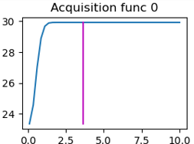
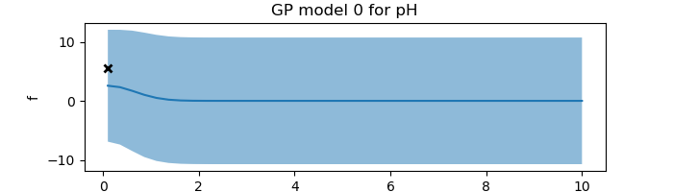
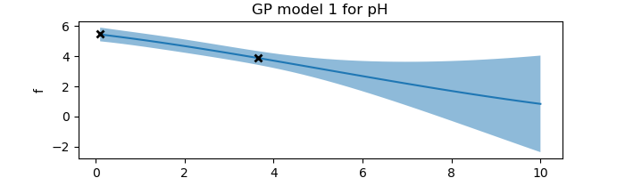
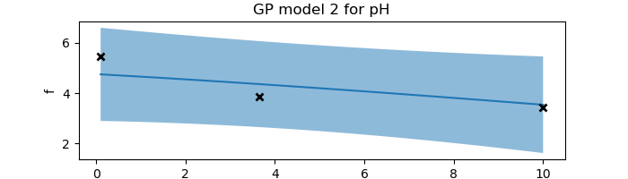
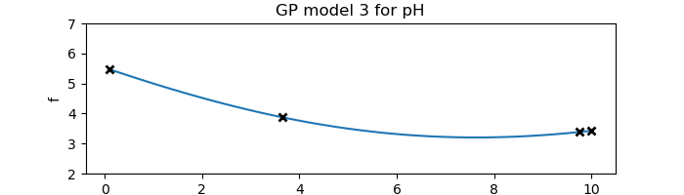
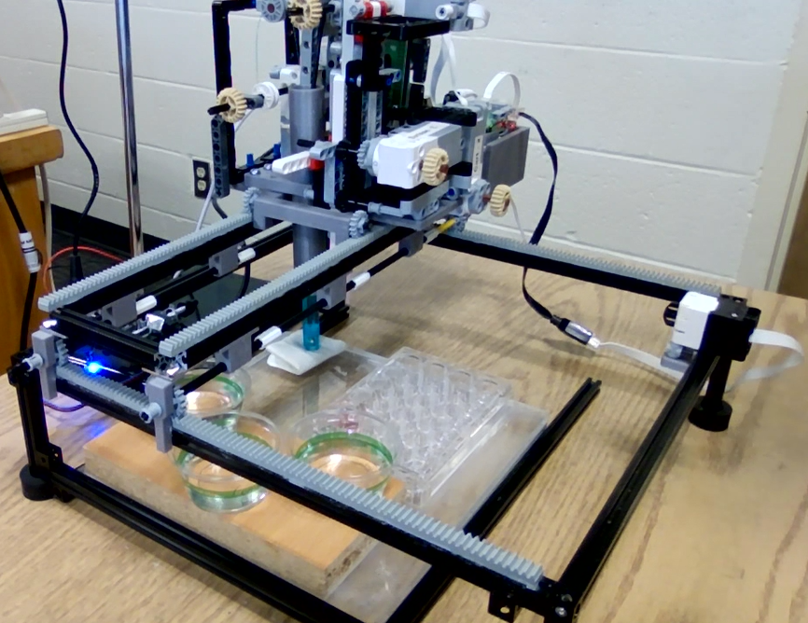
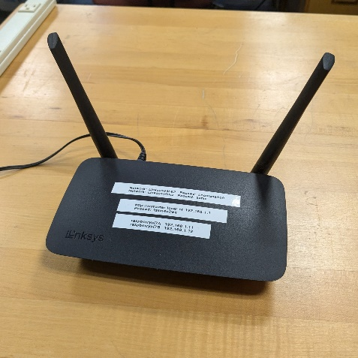
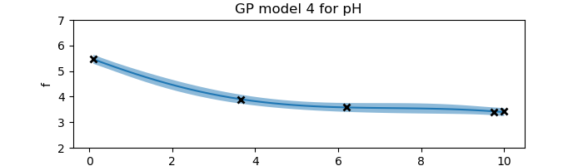
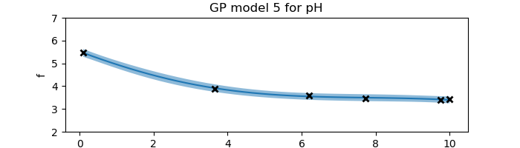
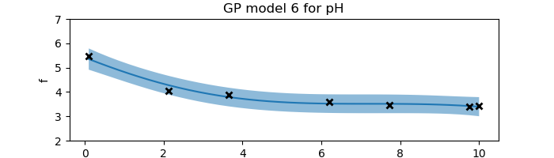
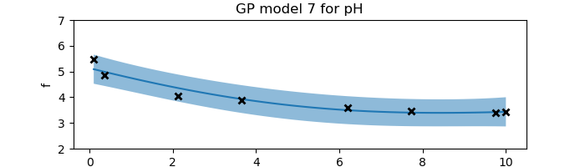
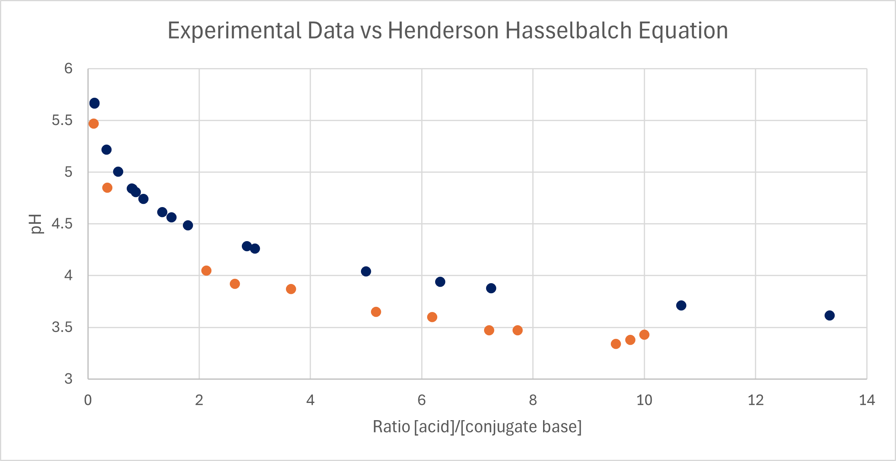
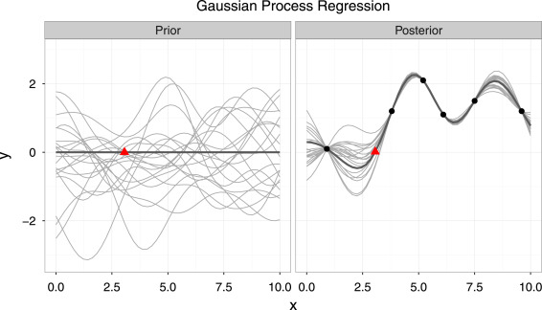
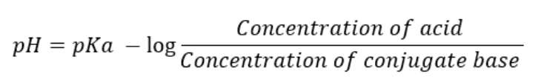
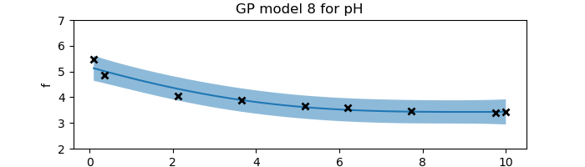

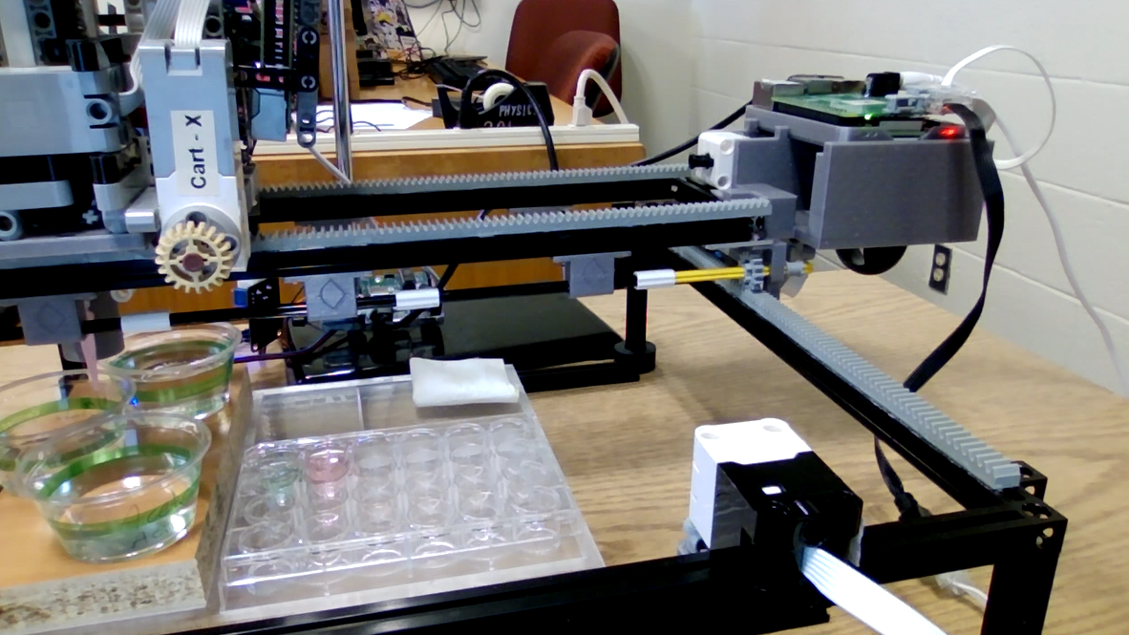
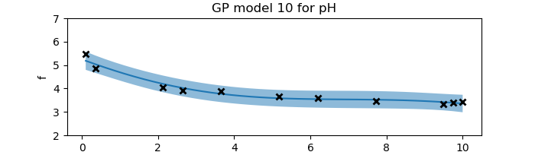
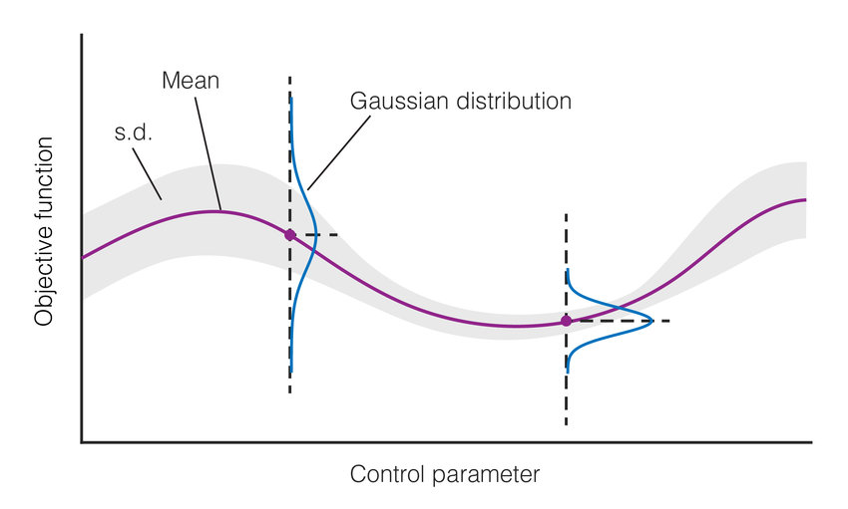
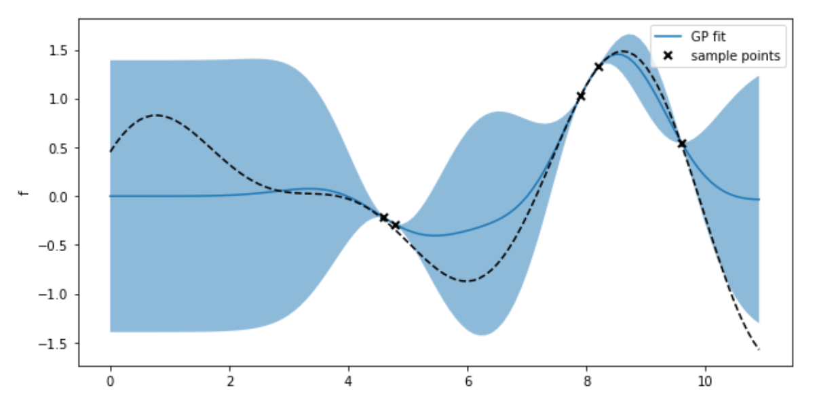
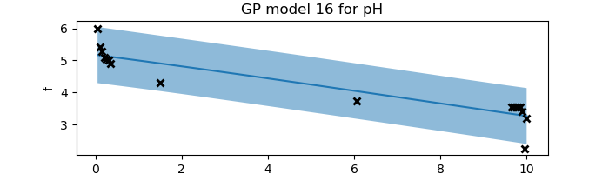
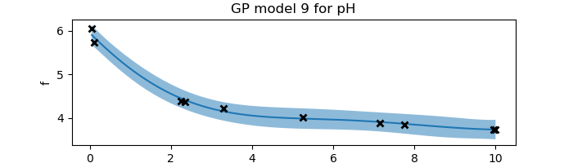
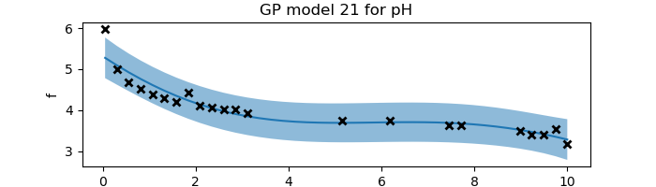
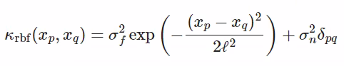
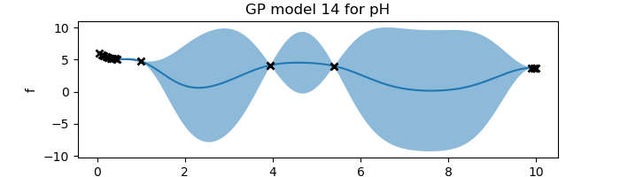
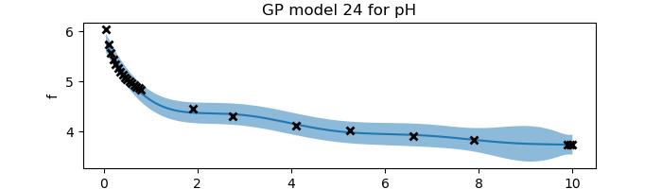
Automation and Machine Learning: How a Robot Can Conduct Its Own Experiments Using Gaussian Processes
Miller Gruen and Adi Timin
Advisor: Dr Mary Lowe, Physics Department, Loyola University Maryland
Introduction
Apparatus
Experimental Results: “Exploration”
What is the real-world problem
Acid/conjugate base
pH measurements
The goal: trying to optimize and autonomize
Add your information, graphs and images to this section.
Add your information, graphs and images to this section.
argmax = … this is for the acquisition function
Theory and Background
Gaussian processes is a method of doing regression. It tells us which functions are most likely to describe the data we are observing at any time during an experiment. When we have no data, our prior model has endless possibilities. Then as we observe more and more data, we get a better idea of the true underlying function. This regression method is non-parametric, which means we don’t have an equation that describes the function we are fitting, just a curve - a set of points.
Henderson Hasselbalch Equation
Lego motor
Experimental data
Figure 1
Water
(rinsing)
Raspberry Pi and Build Hat
In essence, a Gaussian process is a collection of normally distributed random variables. Thus, for each value of the control parameter, we have a Gaussian probability distribution (a.k.a. a Bell curve) as an output. The variance in the distributions tells us about the uncertainty in the function. Where we have a better idea of the underlying function, the distributions are narrower. This plotted variance includes both the uncertainty in the model due to a lack of information (epistemic uncertainty), and the noise and fluctuations in the data itself (aleatoric uncertainty). The uncertainty is plotted on Figure 3 as the light-blue region (2 standard deviations). The darker-blue line on this graph is the mean of the function, what we call the surrogate function. It is the curve that most likely represents the true curve. The underlying curve that we desire to find the shape of is plotted with the black dotted line.
Base
Limit switch
Acid
Figure 2
Standards
Experimental wells
Computational & Experimental Results: New acquisition function
The code is able to:
Establish communication between computer and pis
Functions for:
moving the motors in the x and y directions
Pipetting liquid
Moving pH sensor vertically
pH measurement
Cleaning and drying the pH sensor
GPy code
Function to establish RBF kernel
Function that does the regression
Function that uses active learning methods to determine the next data point to measure
Figure 3
Figure 4
Argmax = 5*sqrt(n)*variance + slope
Acknowledgements
References
Add your information, graphs and images to this section.
Add your information, graphs and images to this section.

